Slide 1


ABDELGHAFOR’S
HACKATHON
Local Library Console
Management System

Slide 2
Python files
01
04
book.py
functions.py
02
05
member.py
data_handler.py
03
06
library.py
06
main.py

Slide 3
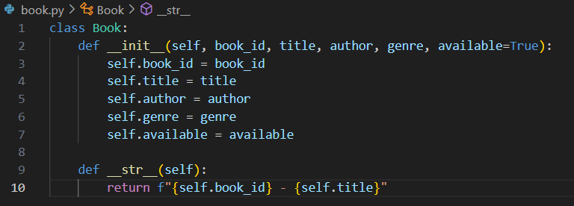
01
book.py
This code defines a class called Book, which represents a book in the library.
The __init__ method initializes a book object with attributes like book_id, title, author, genre, and whether it is available (available defaults to True).
The __str__ method Provides a simple string format for displaying the book's ID and title when the object is printed.

Slide 4
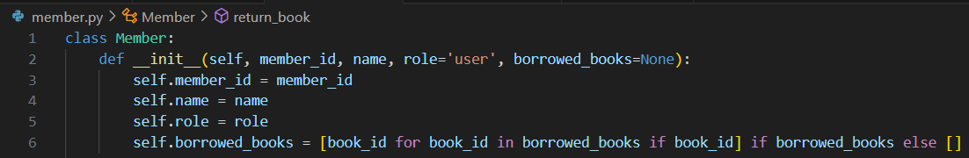
02
member.py
The code defines a Member class, representing a member in the library.
It has attributes like member_id, name, role (defaulting to 'user'), and borrowed_books.
If no books are passed, borrowed_books is set to an empty list.

Slide 5
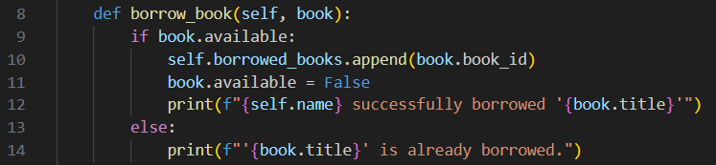
02
member.py
The borrow_book function allows a member to borrow a book if it is available.
It checks the available status of the book. If the book is available, it adds the book_id to the member's borrowed_books list and marks the book as unavailable.
A message confirms the successful borrowing.
If the book is already borrowed, it prints a message informing the member that the book is unavailable.

Slide 6
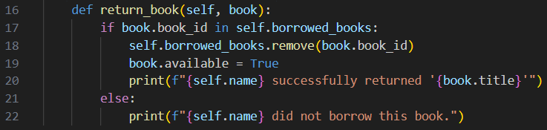
02
member.py
The return_book function allows a member to return a borrowed book.
It first checks if the book_id is in the member's list of borrowed_books. If it is, the book is removed from the list, marked as available again.
A message is printed confirming the return.
If the book wasn't borrowed by the member, a message indicates that they didn’t borrow the book.

Slide 7
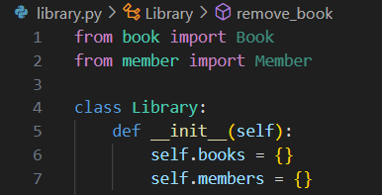
03
library.py
Book and Member classes are imported from their files.
The Library class is created to manage both books and members in the system.
self.books: A dictionary to store books, where each key is the book's ID.
self.members: A dictionary to store members, where each key is the member’s ID.

Slide 8
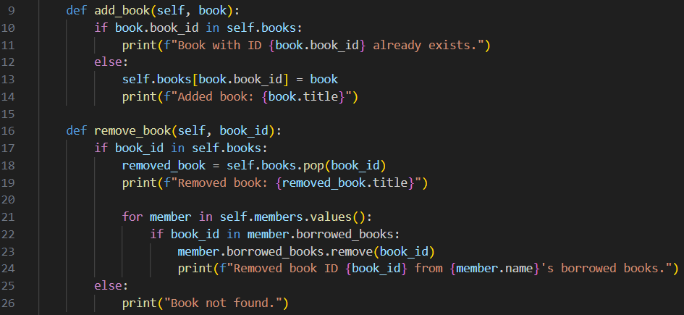
03
library.py
add_book(self, book):checks if a book with the same book_id already exists in the library.
If it does, it prints a message saying the book already exists.
If not, it adds the book to the library's collection and prints a message confirming the addition.
remove_book(self, book_id):checks if a book with the given book_id exists in the library.
If it does, the book is removed from the library's collection, and a message is printed.
Additionally, it checks if any members have borrowed this book and removes it from their lists as well, printing a message for each affected member.
If the book isn’t found, it prints a message saying the book is not in the library.

Slide 9
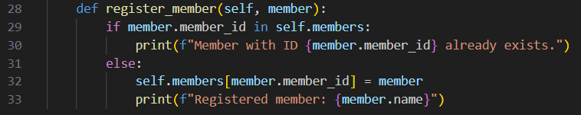
03
library.py
register_member function: adds a new member to the library.
It first checks if a member with the same member_id is already registered.
If the member exists, it prints a message saying the member ID is already taken.
If the member does not exist, it adds the member to the library's list of members and prints a confirmation message with the member's name.

Slide 10
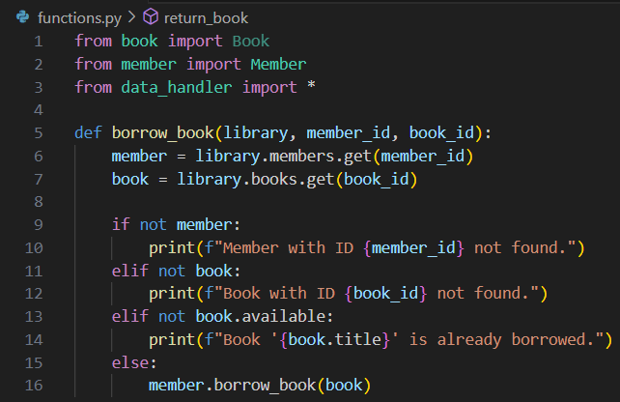
functions.py
04
Book, Member, and data_handler are imported from their files.
borrow_book function is designed to let a library member borrow a book.
It looks up the member using member_id and the book using book_id from the library's collection.
If the member or book isn't found in the library, it prints a message stating that either the member or book doesn't exist.
If the book is found but it is unavailable, it informs the user that the book is already borrowed.
If both the member and book are valid and the book is available, it calls the member's borrow_book() function to complete the borrowing process.

Slide 11
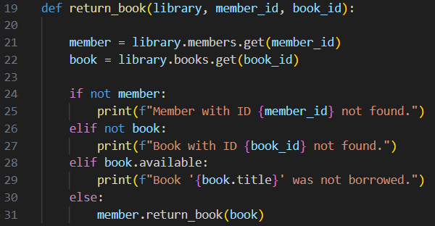
04
functions.py
return_book function allows a member to return a borrowed book..
It retrieves the member using member_id and the book using book_id from the library.
If the member or book doesn’t exist, it prints an error message indicating the member ID or book ID is not found.
If the book is already marked as available, it notifies the user that the book wasn't borrowed.
If the member and book are valid and the book was borrowed, it calls the member’s return_book() method to complete the return process.

Slide 12
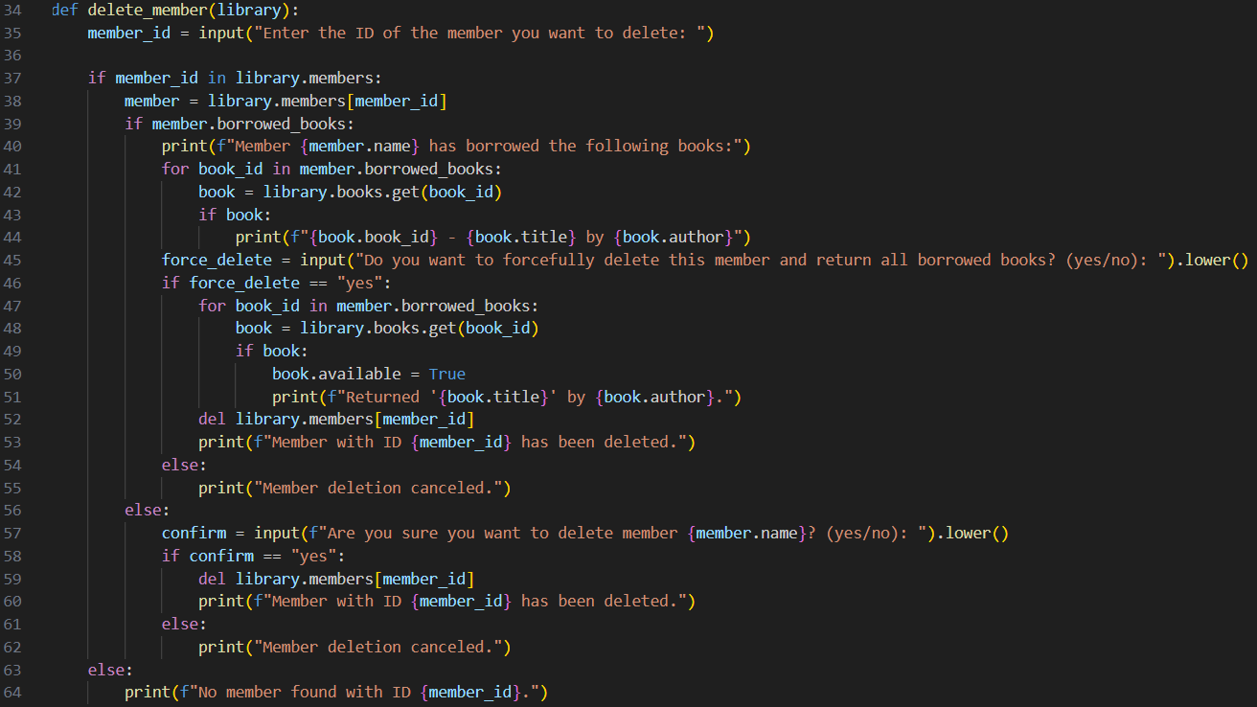
starts by creating a new Library object.
04
functions.py
delete_member function remove a member from the library.
Prompts the user to enter the member’s ID to identify the member to be deleted.
If they have borrowed books, it lists them and asks the user whether to forcefully delete the member, returning all borrowed books in the process.
If the member has no borrowed books, it asks for confirmation to delete.
If the member is deleted, their information is removed from the system.
If the member doesn’t exist, it prints a message indicating that no member was found with the given ID.

Slide 13
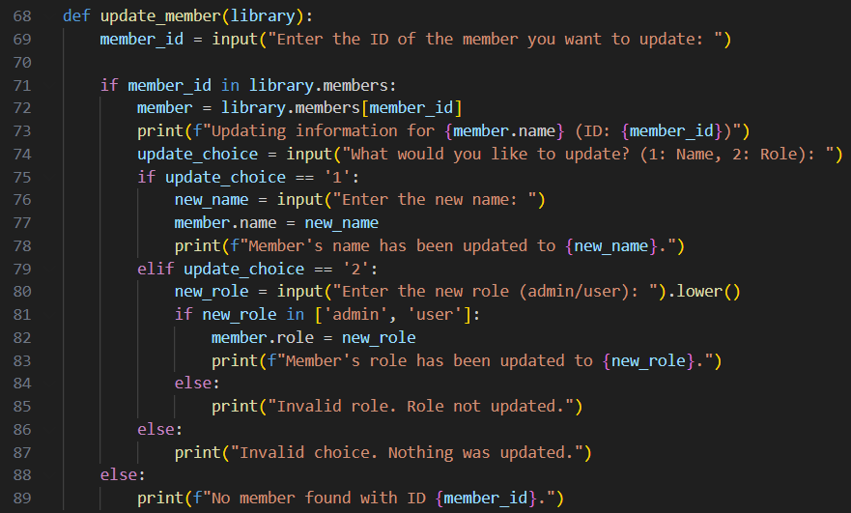
starts by creating a new Library object.
04
functions.py
update_member function lets admin update a member's information.
It first prompts for the member's ID and checks if they exist.
If found, it asks what you want to update (name or role).
Depending on the choice, it updates the member’s name or role and provides confirmation.
If the choice or role is invalid, it shows an error message.
If the member ID isn’t found, it notifies the user.

Slide 14
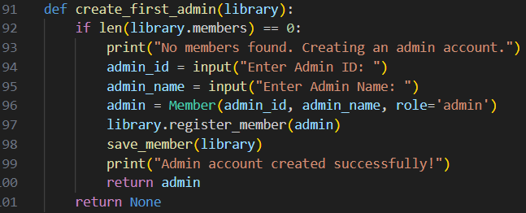
04
functions.py
create_first_admin function sets up an admin account if there are no existing members in the library.
It prompts for the admin’s ID and name, then creates a Member with the role set to 'admin’.
This new admin is added to the library, saved to the member data file, and a success message is printed.
If there are already members in the library, the function does nothing and returns None.

Slide 15
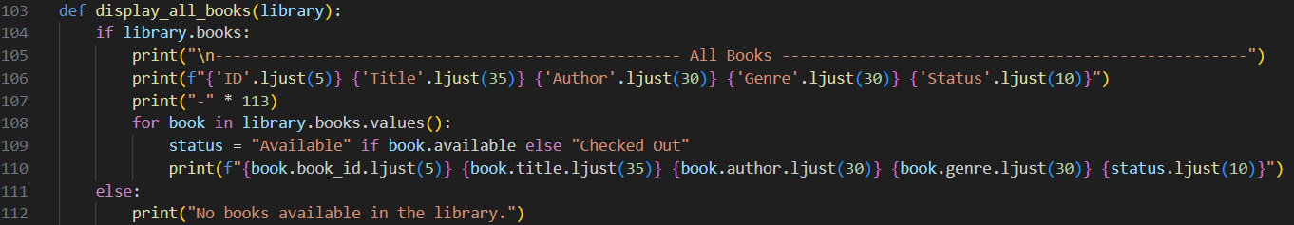
functions.py
04
display_all_books function shows a list of all books in the library.
If there are books, it prints a formatted table with columns for ID, title, author, genre, and status (available or checked out).
If there are no books in the library, it prints a message saying there are no books available.

Slide 16
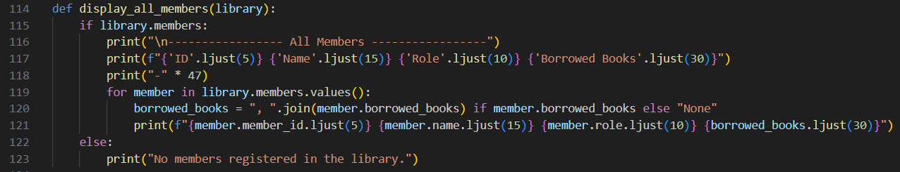
functions.py
04
display_all_members function lists all members of the library.
If there are members, it prints a formatted table showing their ID, name, role, and borrowed books.
Borrowed books are listed as a comma-separated string or shown as "None" if the member has not borrowed any books.
If no members are registered, it prints a message indicating that there are no members.

Slide 17
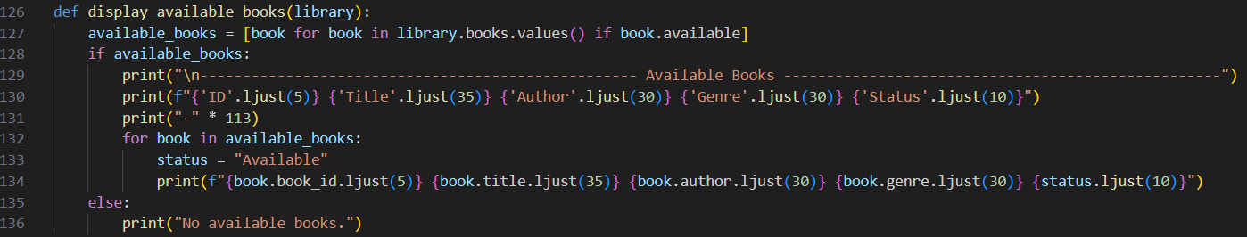
functions.py
04
display_available_books function shows a list of books that are currently available in the library.
It filters the library's books to include only those marked as available.
If there are available books, it prints a formatted table with columns for ID, title, author, genre, and status, indicating that the books are "Available."
If no books are available, it prints a message saying so.

Slide 18
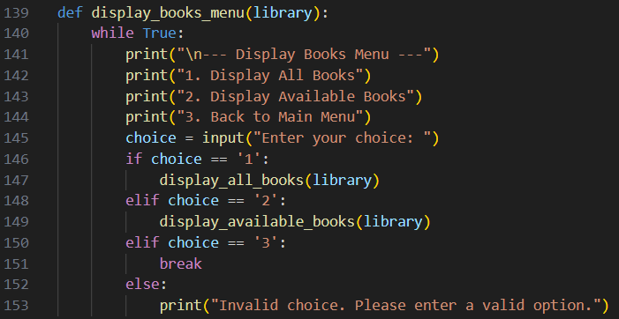
04
functions.py
display_books_menu function shows options to: display all books, display only available books, return to the main menu.
The user makes a choice by entering a number. If they choose '1' or '2', the corresponding function (display_all_books or display_available_books) is called to show the books.
If the choice is '3', the function exits the loop and returns to the main menu.
If the choice is invalid, it prints an error message and prompts the user again.

Slide 19
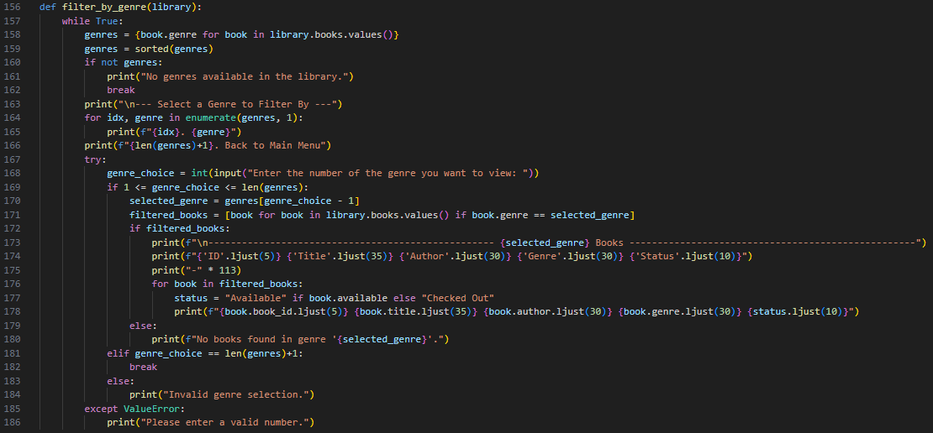
starts by creating a new Library object.
04
functions.py
filter_by_genre function allows users to view books based on their genre.
It shows the available genres with numbers for selection and an option to go back to the main menu.
The user selects a genre by entering a number.
The function filters and displays books of the selected genre, showing their details and status.
If no genres are available, it informs the user and exits.
If the user selects an invalid option or enters a non-numeric input, it displays an error message and prompts for input again.
This loop continues until the user chooses to return to the main menu.

Slide 20
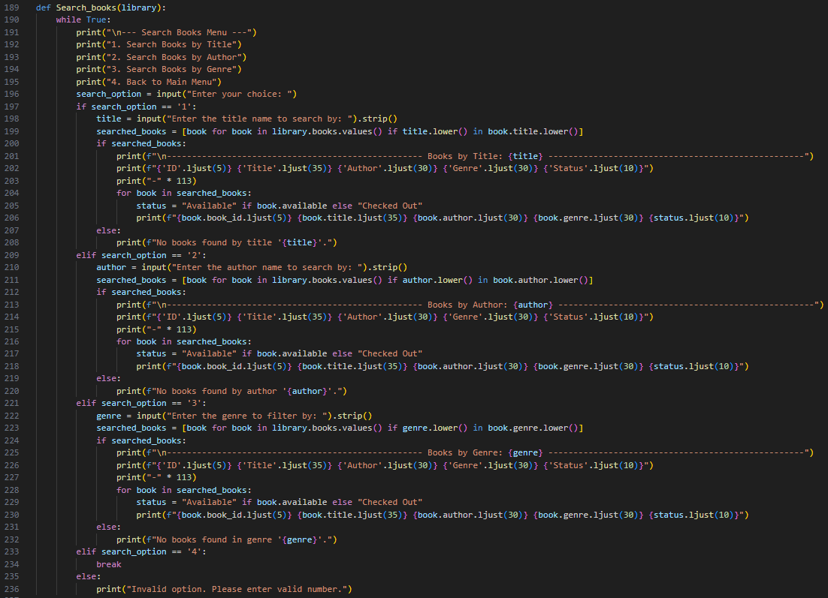
starts by creating a new Library object.
04
functions.py
Search_books function provides a menu for users to search for
books in the library by title, author, or genre.
Search by Title: users can search books containing a specific title.
It displays matching books or a message if none are found.
Search by Author: users can search books by a particular author.
It shows books by the author or a message if no matches are found.
Search by Genre: search for books within a specific genre.
It lists books in that genre or notifies if no books are found.
Selecting the option to return to main menu exits the search menu.
If invalid option is selected, it prompts the user to enter valid number.

Slide 21
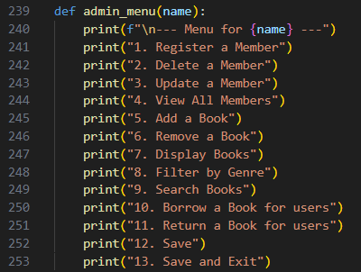
04
functions.py
admin_menu function displays a list of options for an admin user.
It starts by showing a header with the admin's name.
Register a member: allows adding a new member.
Delete a member : deletes an existing member.
Update a member : updates details of a member.
View all member : shows a list of all members.
Add a book: allows adding a new book.
Remove a book: deletes a book from the library.
Display books: shows options for displaying books ( all books or available ones).
Filter by genre: filters books based on genre.
Search books: searches for books by title, author, or genre.
Borrow a book for users: lets the admin borrow a book on behalf of a user.
Return a book for users: lets the admin return a book on behalf of a user.
Save: saves the current data.
Save and Exit: saves data and exits the menu.

Slide 22
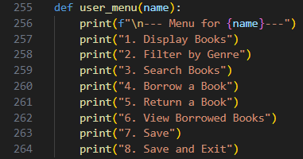
04
functions.py
user_menu function displays a list of options for a user.
It begins by showing a header with the user's name.
Display books: shows a list of books in the library.
Filter by genre: filters books based on genre.
Search books: searches for books by title, author, or genre.
Borrow a book: allows the user to borrow a book.
Return a book: allows the user to return a borrowed book.
View borrowed books: displays a list of books currently borrowed by the user.
Save: saves the current data.
Save and Exit: saves data and exits the menu.

Slide 23
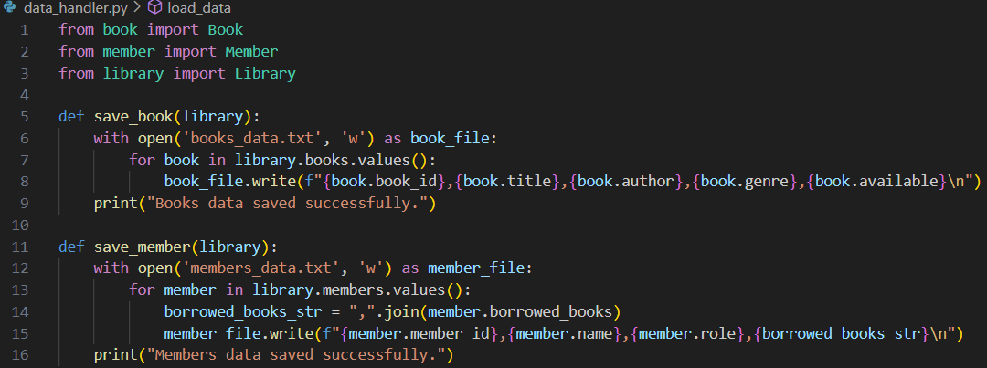
05
data_handler.py
Book, Member, and library classes are imported from their files.
save_book(library):opens a file “books_data.txt” for writing.
Writes details of each book to the file, including book ID, title, author, genre, and availability (each book on a new line).
Prints a message confirming that the book data has been saved.
save_member(library):opens a file “members_data.txt” for writing.
Writes details of each member to the file, including member ID, name, role, and borrowed books (each member on a new line).
Borrowed books are joined into a comma-separated string.
Prints a message confirming that the member data is saved.

Slide 24
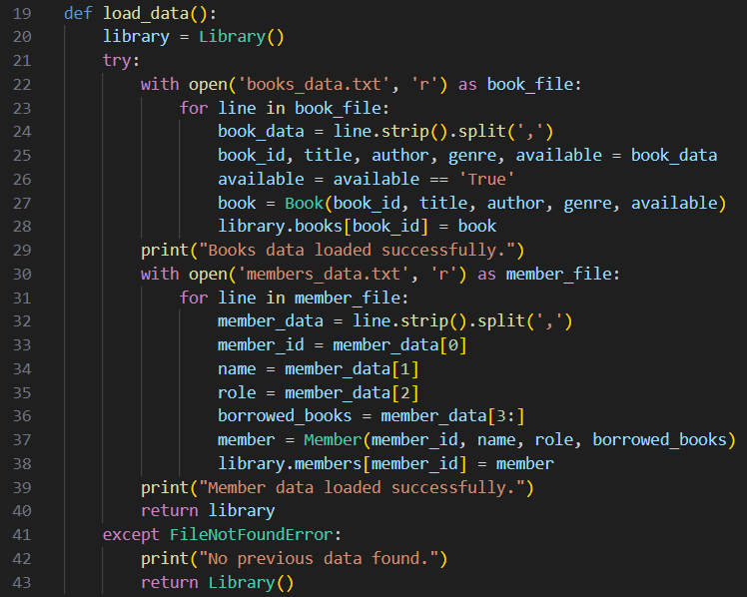
05
data_handler.py
load_data function: starts by creating a new Library object.
Load Books: opens the books_data.txt file and reads each line.
Each line is split by commas to extract book details.
It creates a Book object to add each line to library’s book collection.
A message is printed when the book data is successfully loaded.
Load Members: opens the members_data.txt file and reads each line.
Each line is split by commas to get member details.
It creates a Member object for each line and adds it to the library’s member collection.
A message is printed when the member data is successfully loaded.
If the files are not found, it prints a message and returns a new, empty Library instance.

Slide 25
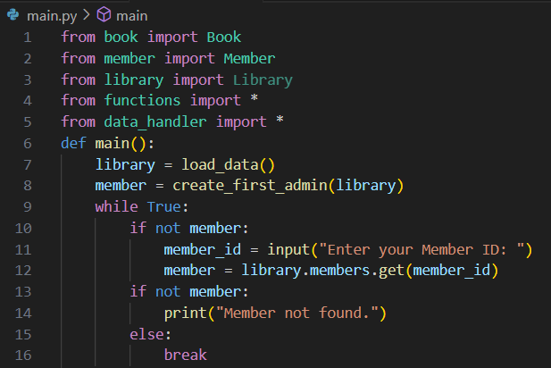
06
main.py
Book, ,member, library, fuctions and data_handler files are imported.
main function for the library system.
It first loads the library data using the load_data() function.
It checks if there are no members in the system, and if true, it creates the first admin using the create_first_admin(library) function.
User login: the code then enters a loop where it asks for a member's ID to identify the user.
If the entered member ID doesn't exist in the system, it shows "Member not found." Once a valid member is found, the loop exits, allowing further interaction with the system.

Slide 26
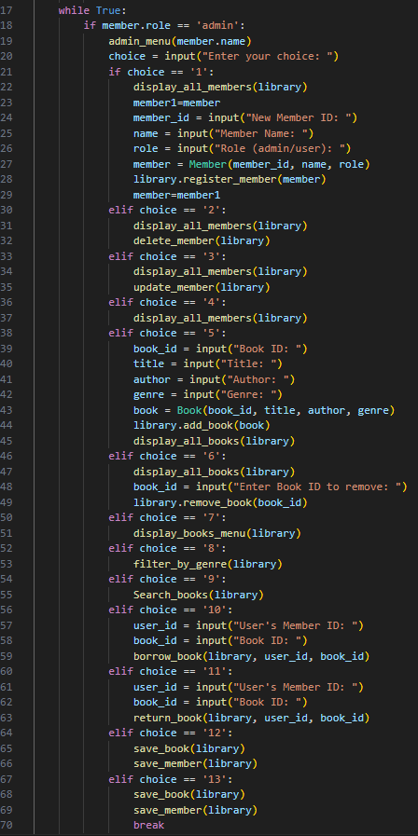
06
main.py
This code is for the main loop of an admin in a library management system.
It displays an admin menu and waits for the admin to choose an option.
Depending on the choice, the admin can register, update, or delete members, as well as add or remove books.
The admin can also view and filter books, manage borrowed books for users, and save the changes.
The loop continues until the admin chooses to save and exit the system.

Slide 27
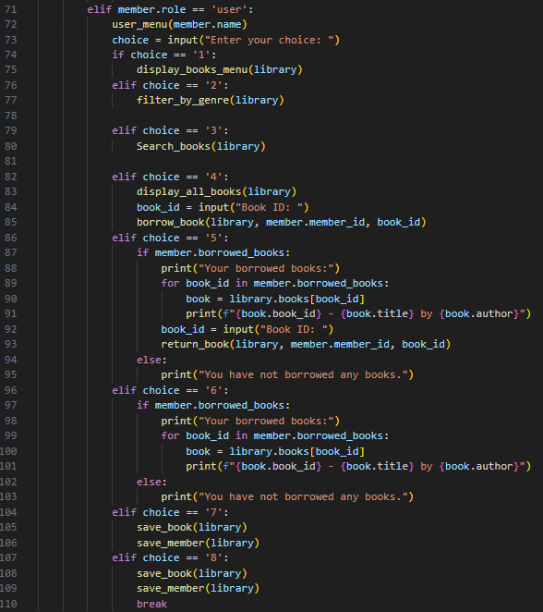
main.py
06
This code handles the user menu for members with the role of "user" in a library system.
It presents various options, allowing the user to display books, filter by genre, or search for books.
Users can also borrow or return books, and view a list of books they have borrowed.
The system provides options to save changes or exit.
The loop continues until the user selects the option to save and exit.

Slide 28
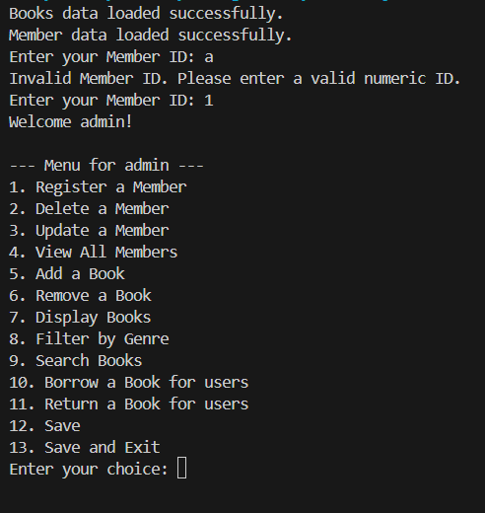
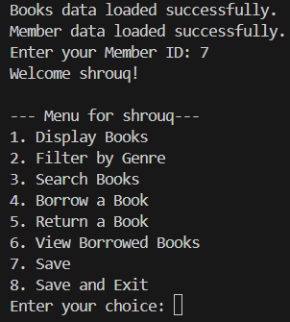
It's official – we got it running!
Main.py
The books, and members data are loaded successfully.
It asks for member ID.
If the user don’t write a number, it inform the user to enter a valid numeric ID.
When the user write a correct and valid number ID, the menu is displayed.

Slide 29


THANK YOU!
Mohamed Salem
Shrouq Ashraf

